Slide 1
AWS CLOUD FORMATION TEMPLATE AND MAIN SERVICES
Prepared by Josh
Devops & AWS
Josh.kidfileapp@gmail.com

Slide 2
AWS - This is a cloud platform that is owned by Amazon, and which provides broad cloud services to many people in the world from different data services.

Slide 3
Three-Tier Architecture
A three-tier architecture is a software architecture with three key logical tiers: the presentation layer, the business logic layer and the data storage layer.
This architecture is used in a client-server application such as a web application that has the frontend, the backend and the database.
The Webserver Tier
The Application Server Tier
The Data Tier

Slide 4
Benefits of Deploying a Three-Tier Architecture on AWS
Modularity: The essence of having a three-tier architecture is to modularize our application such that each part can be managed independently of each other.
With modularity, teams can focus on different tiers of the application and changes made as quickly as possible.
Also, modularization helps us recover quickly from an unexpected disaster by focusing solely on the faulty part.

Slide 5
Benefits of Deploying a Three-Tier Architecture on AWS
Scalability: Each tier of the architecture can scale horizontally to support the traffic and request demand coming to it.
This can easily be done by adding more EC2 instances to each tier and load balancing across them.
For instance, assuming we have two EC2 instances serving our backend application and each of the EC2 instances is working at 80% CPU utilization, we can easily scale the backend tier by adding more EC2 instances to it so that the load can be distributed.
We can also automatically reduce the number of the EC2 instances when the load is less.

Slide 6
Benefits of Deploying a Three-Tier Architecture on AWS
High Availability: With the traditional data center, our application is sitting in one geographical location.
If there is an earthquake, flooding or even power outage in that location where our application is hosted, our application will not be available.
With AWS, we can design our infrastructure to be highly available by hosting our application in different locations known as the availability zones.

Slide 7
Benefits of Deploying a Three-Tier Architecture on AWS
Fault Tolerant: We want our infrastructure to comfortably adapt to any unexpected change both to traffic and fault.
This is usually done by adding a redundant system that will account for such a hike in traffic when it does occur.
So instead of having two EC2 instances working at 50% each, such that when one instance goes bad, the other instance will be working at 100% capacity until a new instance is brought up by our Auto Scaling Group, we have extra instance making it three instances working at approximately 35% each.
This is usually a tradeoff made against the cost of setting up a redundant system.

Slide 8
Benefits of Deploying a Three-Tier Architecture on AWS
Security: We want to design an infrastructure that is highly secured and protected from the prying eyes of hackers.
As much as possible, we want to avoid exposing our interactions within the application over the internet.
This simply means that the application will communicate within themselves with a private IP.
The presentation (frontend) tier of the infrastructure will be in a private subnet (the subnet with no public IP assigned to its instances) within the VPC.

Slide 9
Benefits of Deploying a Three-Tier Architecture on AWS
Users can only reach the frontend through the application load balancer.
The backend and the database tier will also be in the private subnet because we do not want to expose them over the internet.
We will set up the Bastion host for remote SSH and a NAT gateway for our private subnets to access the internet.
The AWS security group helps us limit access to our infrastructure setup.

Slide 10
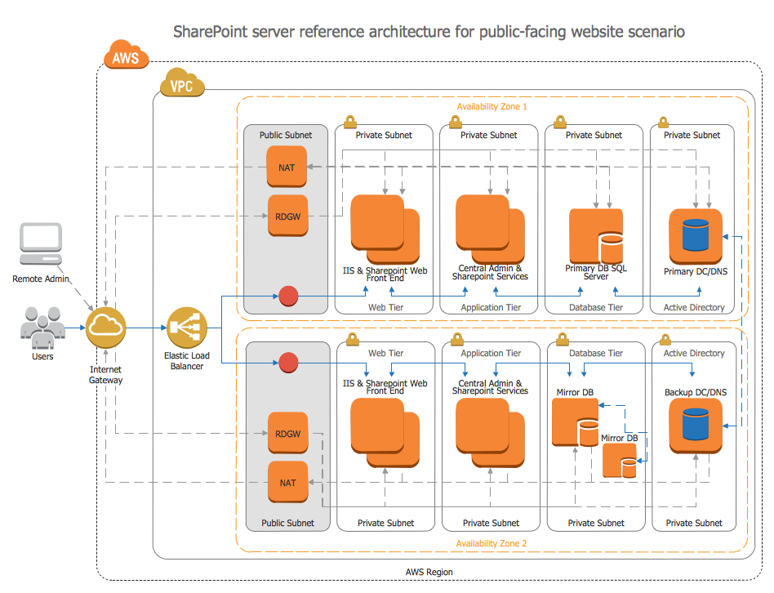

Slide 11
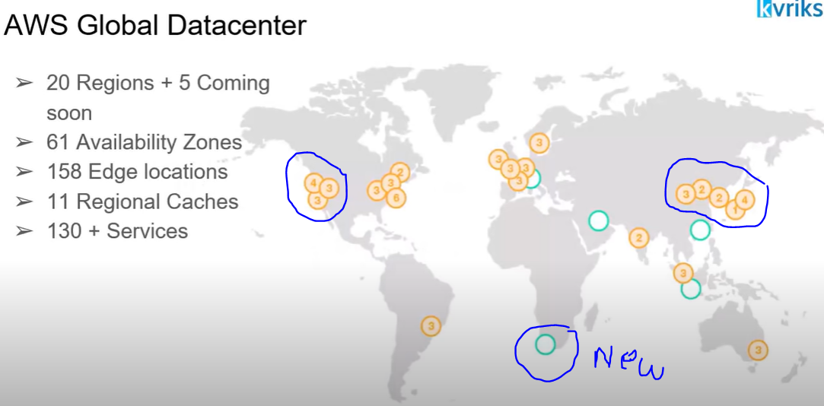

Slide 12
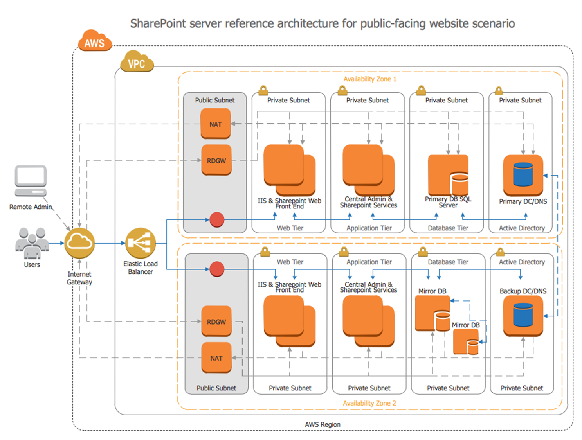
Widely Used Services in AWS
A VPC is an isolated private network that AWS gives to the clients for resource placement, connectivity, and security.

Slide 13
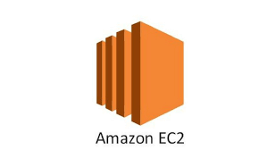
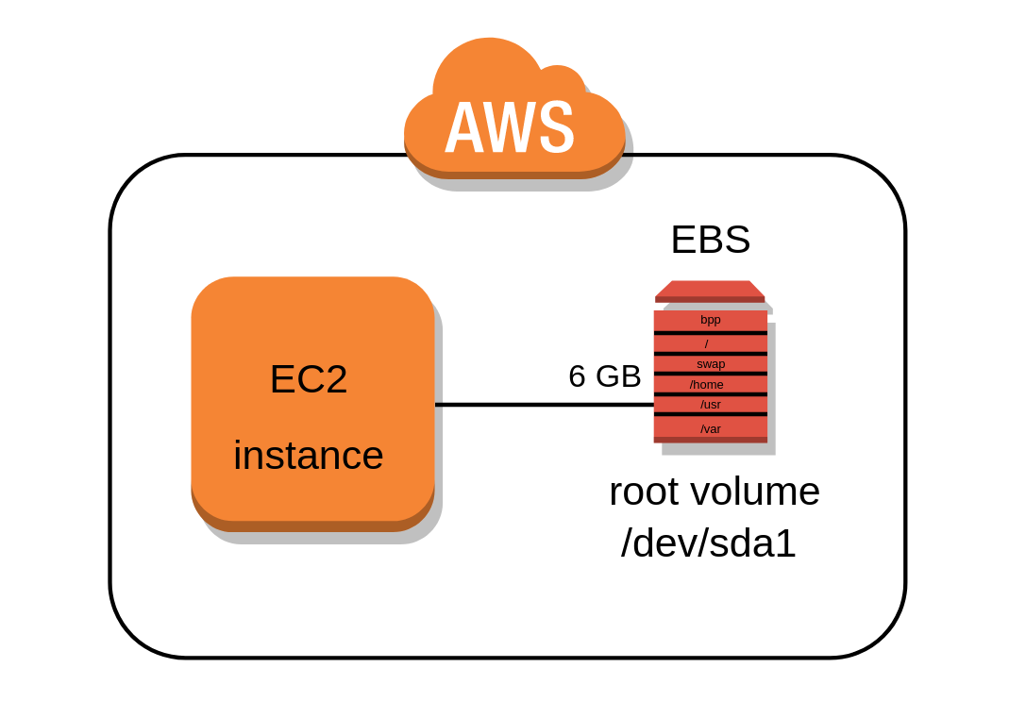
Widely Used Services in AWS
Amazon Elastic Compute Cloud (Amazon EC2) is a web service that provides secure, resizable compute capacity in the cloud.
Elastic Block Storage
EBS is a storage service that is attached to EC2 to store data it's just like a hard drive.
EBS and EC2 instances should be in the same availability zone.
EBS is not only the storage service in AWS. EBS is block storage.

Slide 14
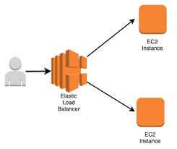
Widely Used Services in AWS
Elastic Load Balancing (ELB) is a load-balancing service for Amazon Web Services (AWS) deployments.
ELB automatically distributes incoming application traffic and scales resources to meet traffic demands.
ELB helps an IT team adjust capacity according to incoming application and network traffic

Slide 15
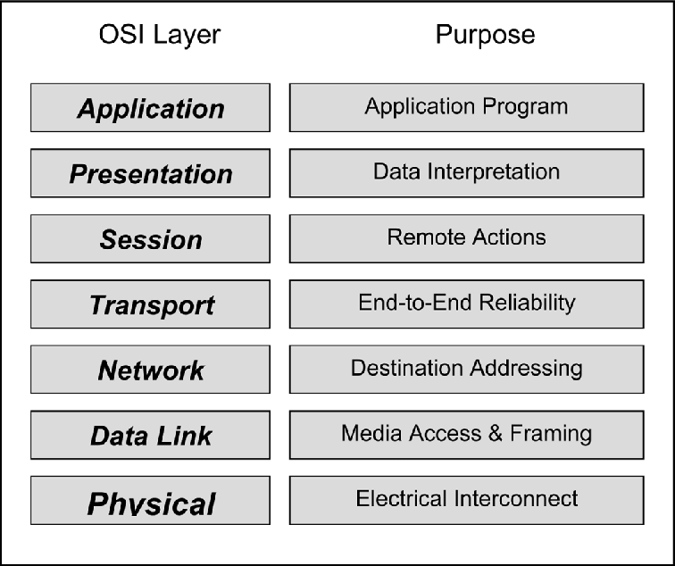
Widely Used Services in AWS
Application Load Balancer
Network Load Balancer
Classic Load Balancer
Gateway Load Balancers

Slide 16
Widely Used Services in AWS
AWS Auto Scaling monitors your applications and automatically adjusts capacity to maintain steady, predictable performance at the lowest possible cost.
Fleet Management
Dynamic Autoscaling
Predictive Autoscaling
Dynamic scaling responds to changing demand and predictive scaling automatically schedules the right number of EC2 instances based on predicted demand. Dynamic scaling and predictive scaling can be used together to scale faster.

Slide 17

Widely Used Services in AWS

Slide 18
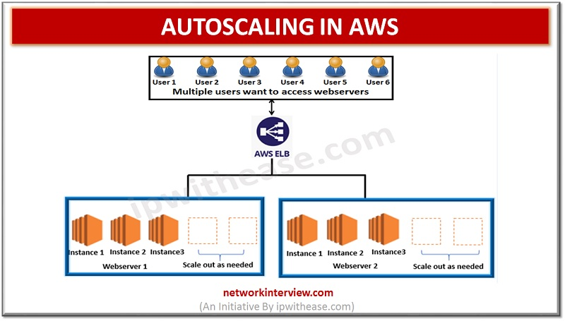
Widely Used Services in AWS

Slide 19
Widely Used Services in AWS
Fleet management
Used for:
Replacing unhealthy instances;
Distributing instances among availability-zones to maximize resilience; E.g: You're running instances in us-east, so auto-scaling can provision instances in the following AZs: us-east-1a, us-east-1b, us-east-1c, us-east-1d, and us-east-1e;
Dynamic scaling
Used for:
Scaling based on CloudWatch alarm metrics or a metric type (more on that later) when a threshold is met, or different measures should be taken depending on the breach of a CloudWatch alarm threshold.

Slide 20
Widely Used Services in AWS
Fleet management
Used for:
Replacing unhealthy instances;
Distributing instances among availability-zones to maximize resilience; E.g: You're running instances in us-east, so auto-scaling can provision instances in the following AZs: us-east-1a, us-east-1b, us-east-1c, us-east-1d, and us-east-1e;
Dynamic scaling
Used for:
Scaling based on CloudWatch alarm metrics or a metric type (more on that later) when a threshold is met, or different measures should be taken depending on the breach of a CloudWatch alarm threshold.

Slide 21
Widely Used Services in AWS
DNS is important because it maps the domain names to the load balancer.
Amazon Route 53 is a highly available and scalable cloud Domain Name System (DNS) web service.
It is designed to give developers and businesses an extremely reliable and cost-effective way to route end users to Internet applications by translating names like www.example.com into the numeric IP addresses like 192.0.2.1 that computers use to connect to each other.
Amazon Route 53 is fully compliant with IPv6 as well.

Slide 22
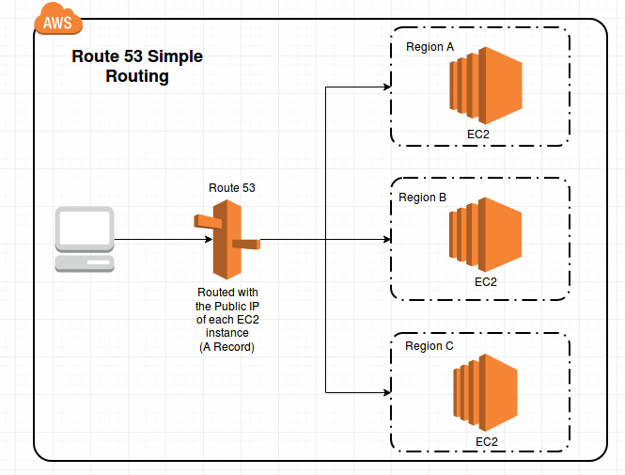
Widely Used Services in AWS

Slide 23
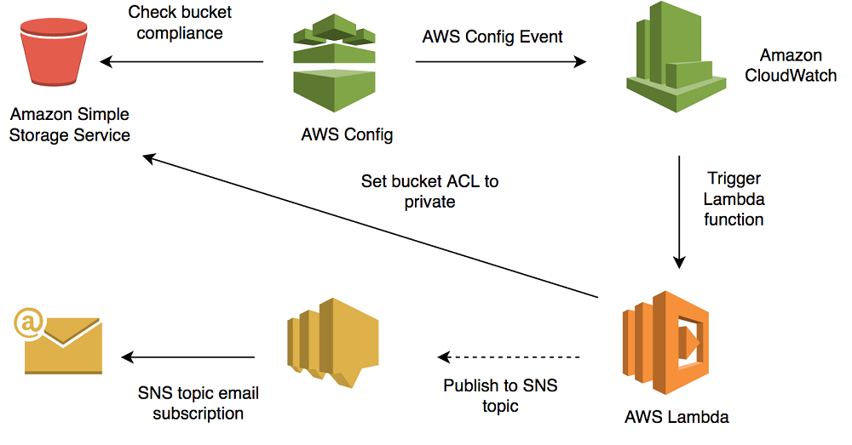
Widely Used Services in AWS
Amazon Simple Storage Service (Amazon S3) is an object storage service that offers industry-leading scalability, data availability, security, and performance.
Has unlimited space.
Elastic Block Storage has limited space.
Accessible through the internet

Slide 24

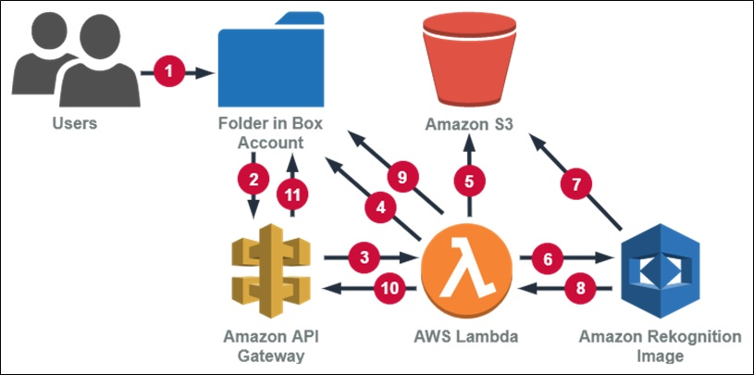
Widely Used Services in AWS
Amazon Rekognition makes it easy to add image and video analysis to your applications using proven, highly scalable, deep learning technology that requires no machine learning expertise to use.
With Amazon Rekognition, you can identify objects, people, text, scenes, and activities in images and videos, as well as detect any inappropriate content.

Slide 25
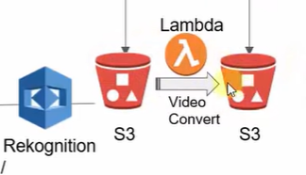
Widely Used Services in AWS
AWS Lambda is a serverless compute service that lets you run code without provisioning or managing servers, creating workload-aware cluster scaling logic, maintaining event integrations, or managing runtimes.

Slide 26
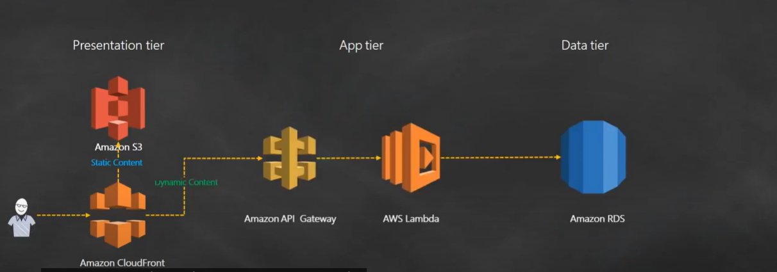
Widely Used Services in AWS
AWS Lambda is a serverless compute service that lets you run code without provisioning or managing servers, creating workload-aware cluster scaling logic, maintaining event integrations, or managing runtimes. No need of a server. Just run the Python scripting codes, Bash shell scripting

Slide 27
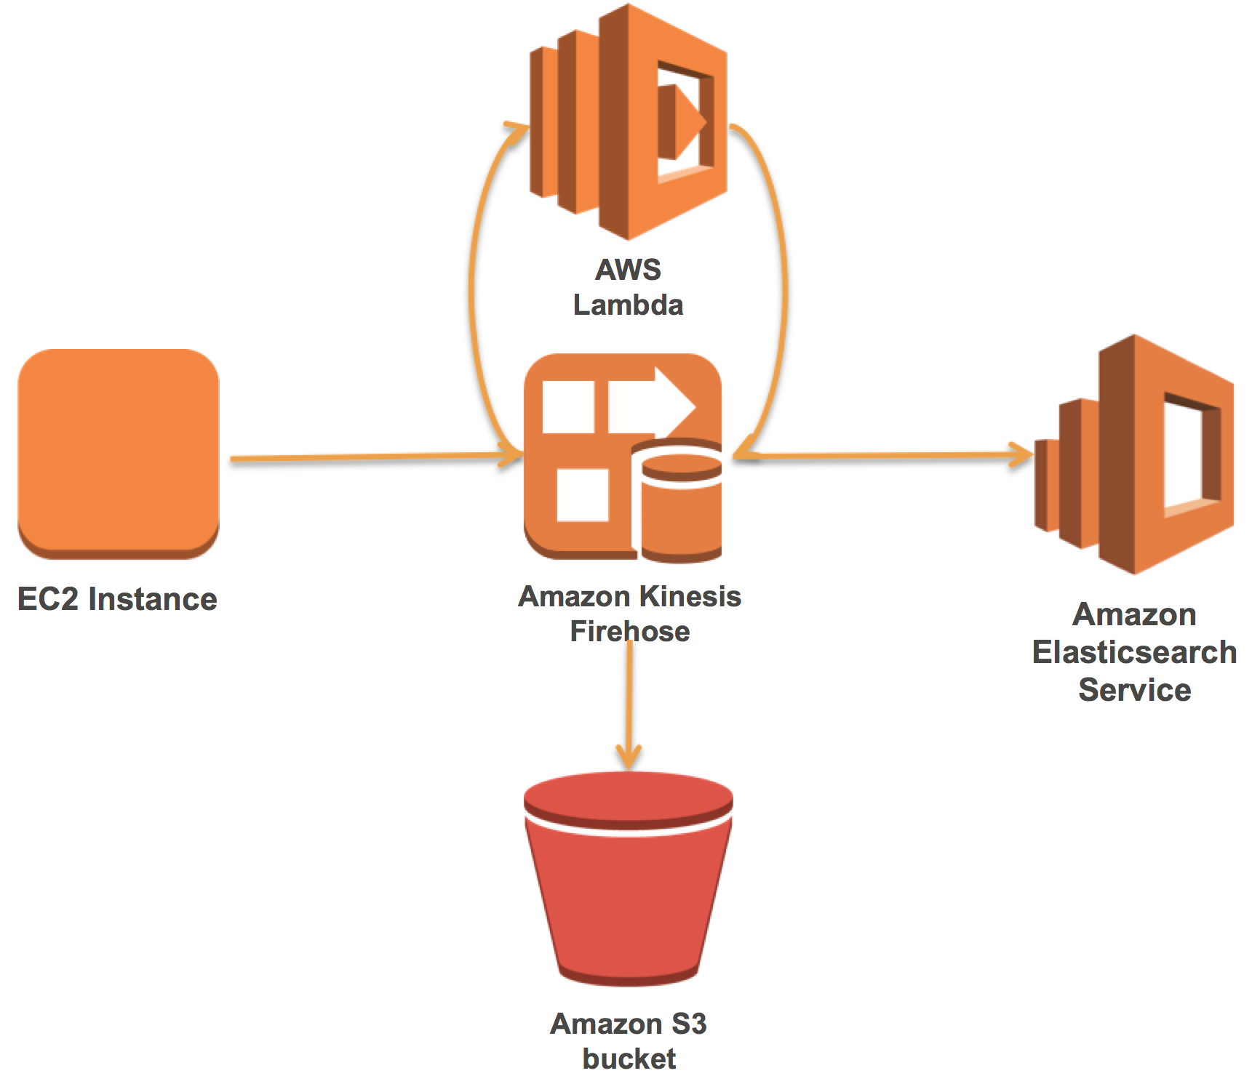
Widely Used Services in AWS
Amazon Kinesis makes it easy to collect, process, and analyze real-time, streaming data so you can get timely insights and react quickly to new information.

Slide 28
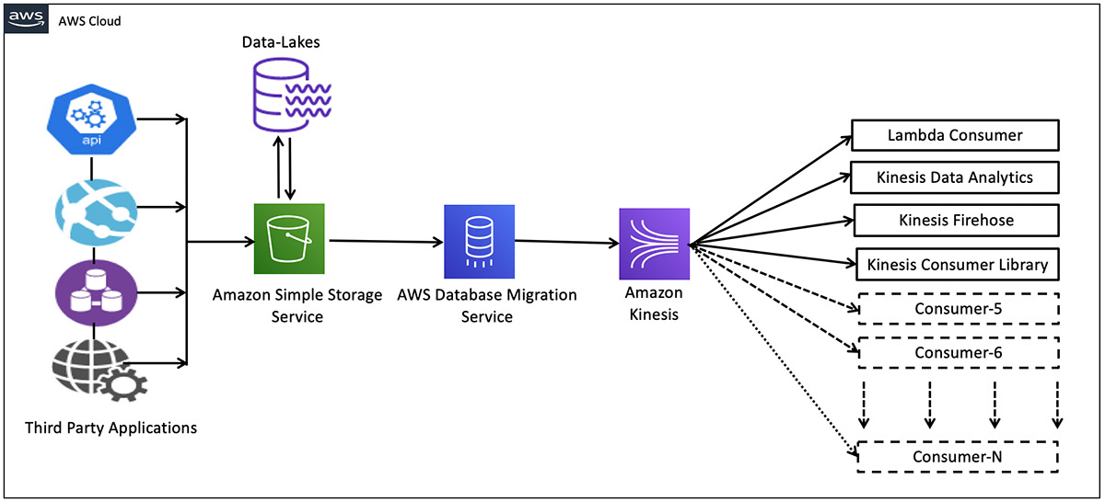
Widely Used Services in AWS

Slide 29
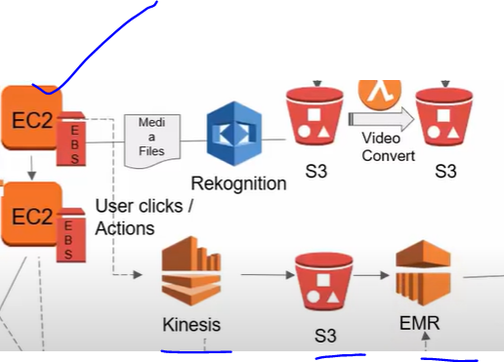
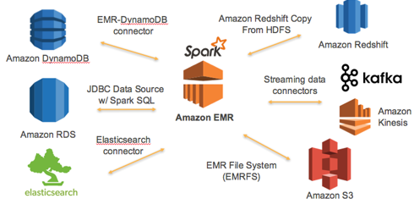
Widely Used Services in AWS
Amazon EMR is the industry-leading cloud big data platform for processing vast amounts of data using open-source tools such as Apache Spark, Apache Hive, Apache HBase, Apache Flink, Apache Hudi, and Presto.

Slide 30
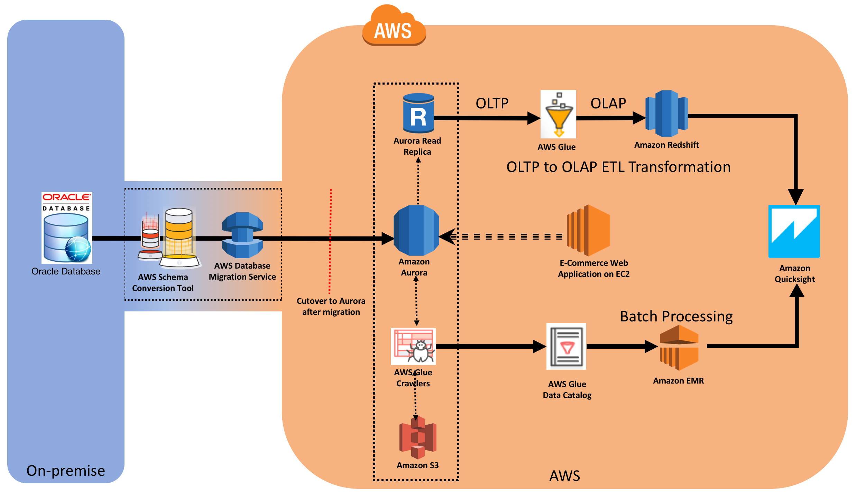
Widely Used Services in AWS
AWS Glue is a serverless data integration service that makes it easy to discover, prepare, and combine data for analytics, machine learning, and application development. Turn data into different formats that can be processed by EMR and then stored in Redshift ( Data Warehouse).

Slide 31
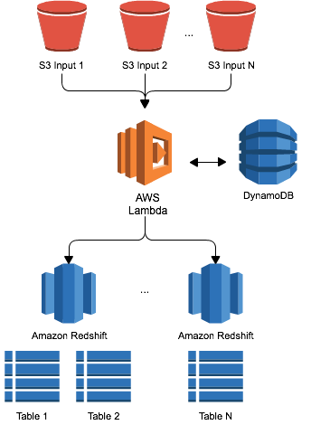
Widely Used Services in AWS
Amazon Redshift is a data warehouse product which forms part of the larger cloud-computing platform Amazon Web Services.

Slide 32
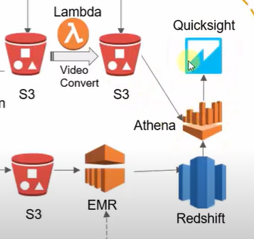
Widely Used Services in AWS
The Amazon QuickSight BI utility enables businesses to create and analyze data visualizations and extract easy-to-understand insights to inform business decision-Making. You can also use Athena

Slide 33
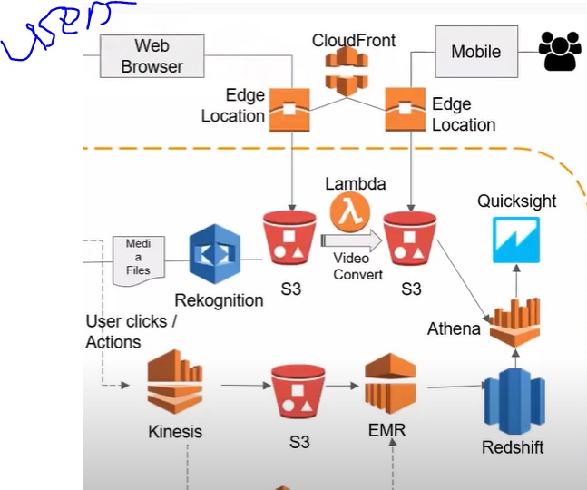
Widely Used Services in AWS
Amazon CloudFront is a fast content delivery network (CDN) service that securely delivers data, videos, applications, and APIs to customers globally with low latency, high transfer speeds, all within a developer-friendly environment.
It is in the edge locations which are across many cities in the world

Slide 34
Widely Used Services in AWS
In a static model, this means that all vehicles traveling on the link experience the same travel time. In a dynamic model with FIFO, this means that all vehicles entering the link at a given point in time experience the same travel time.

Slide 35
Widely Used Services in AWS
In a static model, this means that all vehicles traveling on the link experience the same travel time. In a dynamic model with FIFO, this means that all vehicles entering the link at a given point in time experience the same travel time.

Slide 36
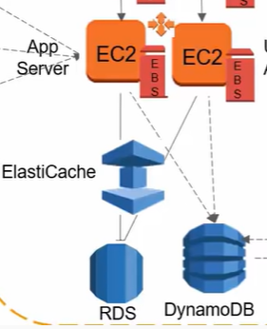
Widely Used Services in AWS
Amazon Elastic Cache allows you to seamlessly set up, run, and scale popular open-source compatible in-memory data stores in the cloud.
Build data-intensive apps or boost the performance of your existing databases by retrieving data from high throughput and low latency in-memory data stores.
Has both Redis and Mem cache.
Reduces the workload for both RDS and Dynamo DB
to prevent a bottleneck from happening in the data tier

Slide 37
Widely Used Services in AWS
Amazon Relational Database Service (Amazon RDS) makes it easy to set up, operate, and scale a relational database in the cloud.
It provides cost-efficient and resizable capacity while automating time-consuming administration tasks such as hardware provisioning, database setup, patching and backups.

Slide 38
Widely Used Services in AWS
Amazon DynamoDB is a key-value and document database that delivers single-digit millisecond performance at any scale.
DynamoDB is a proprietary NoSQL database service built by Amazon and offered as part of the Amazon Web Services (AWS) portfolio.
The name comes from Dynamo, a highly available key-value store developed in response to holiday outages on the Amazon e-commerce platform in 2004

Slide 39
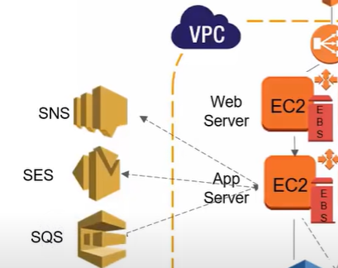
Widely Used Services in AWS
Amazon Simple Notification Service (Amazon SNS) is a fully managed messaging service for both application-to-application (A2A) and application-to-person (A2P) communication.
Amazon Simple Email Service (SES) is a cost-effective, flexible, and scalable email service that enables developers to send mail from within any application.
Amazon SQS is a message queue service used by distributed applications to exchange messages through a polling model and can be used to decouple sending and receiving components.

Slide 40
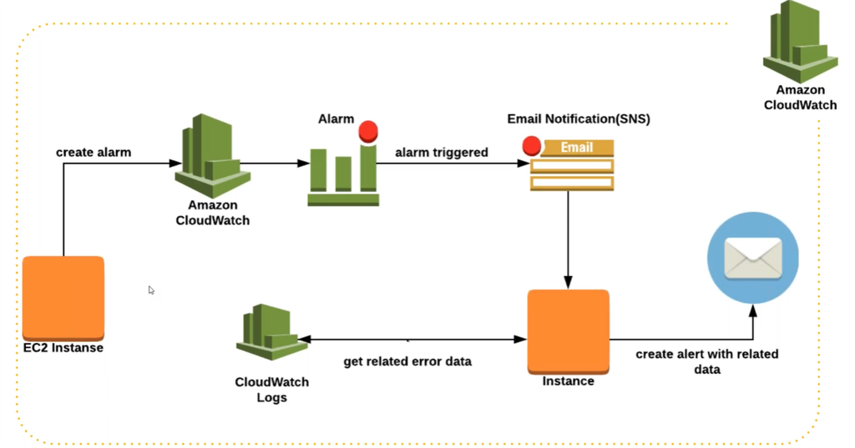
Widely Used Services in AWS
Amazon CloudWatch is a monitoring and observability service built for DevOps engineers, developers, site reliability engineers (SREs), and IT managers. CloudWatch provides you with data and actionable insights to monitor your applications, respond to system-wide performance changes, optimize resource utilization, and get a unified view of operational health.

Slide 41
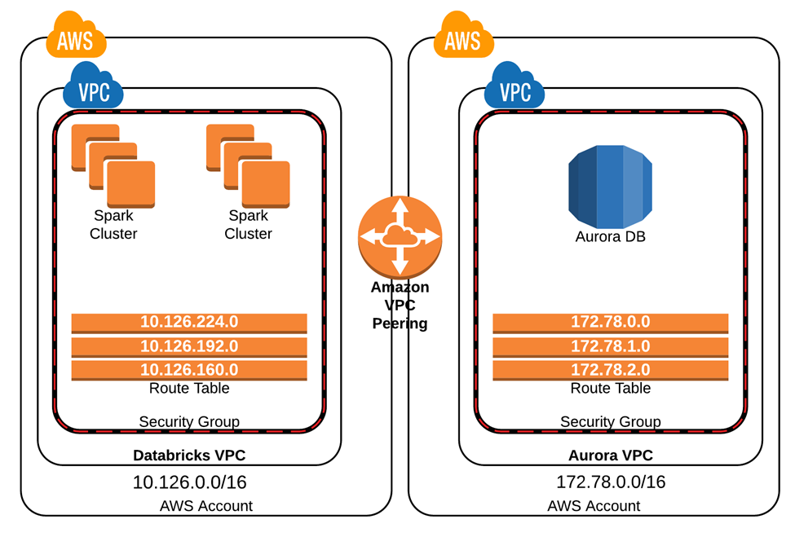
Widely Used Services in AWS
A route table contains a set of rules, called routes, that are used to determine where network traffic from your subnet or gateway is directed. To put it simply, a route table tells network packets which way they need to go to get to their destination.

Slide 42
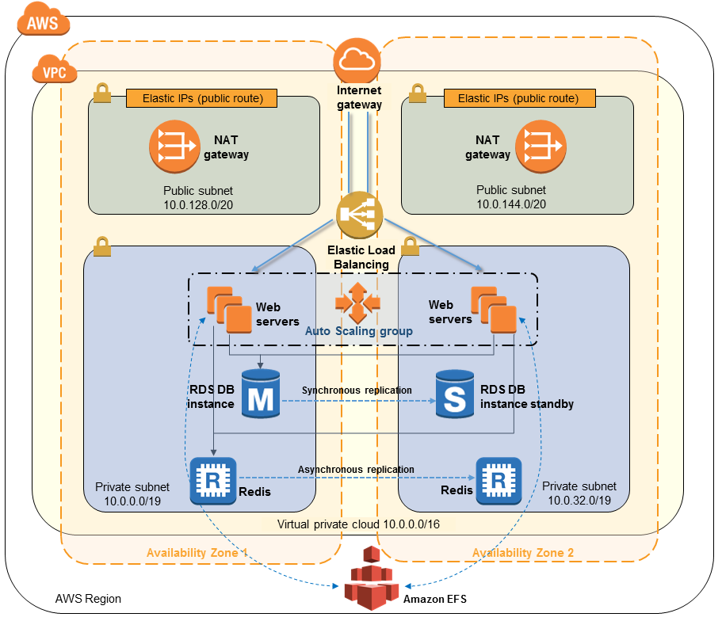
Widely Used Services in AWS
A route table contains a set of rules, called routes, that are used to determine where network traffic from your subnet or gateway is directed.
To put it simply, a route table tells network packets which way they need to go to get to their destination.

Slide 43
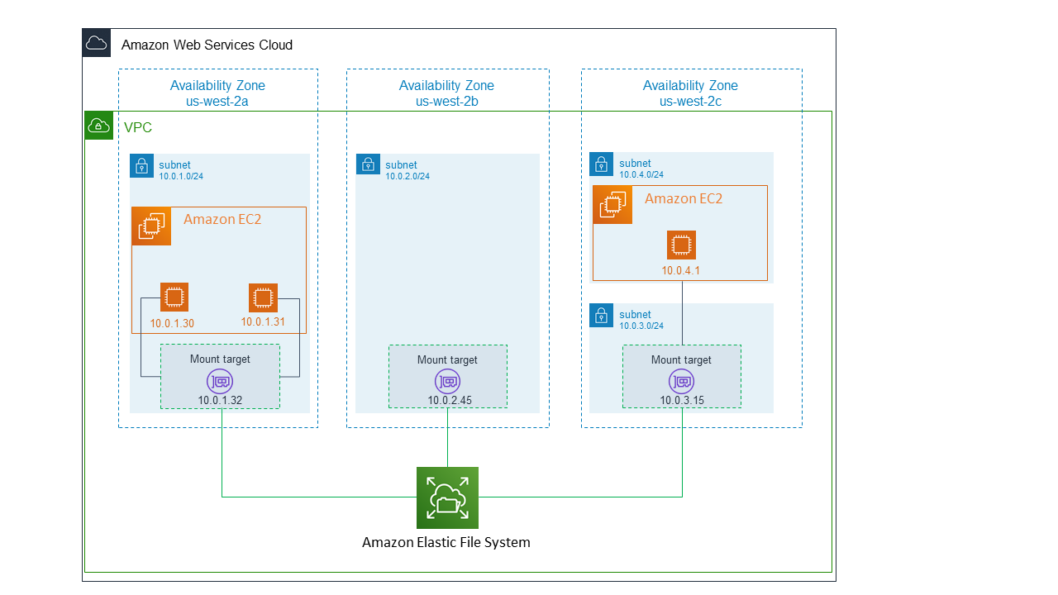
Widely Used Services in AWS
A mount target is an NFS endpoint that lives in a VCN subnet of your choice and provides network access for file systems.

Slide 44

Widely Used Services in AWS
AWS Identity and Access Management (IAM) enables you to manage access to AWS services and resources securely. Using IAM, you can create and manage AWS users and groups, and use permissions to allow and deny their access to AWS resources.
AWS Key Management Service (KMS) makes it easy for you to create and manage cryptographic keys and control their use across a wide range of AWS services and in your applications.
SSL/TLS certificates are used to secure network communications and establish the identity of websites over the Internet as well as resources on private networks.
AWS WAF is a web application firewall that helps protect your web applications or APIs against common web exploits and bots that may affect availability, compromise security, or consume excessive resources.

Slide 45

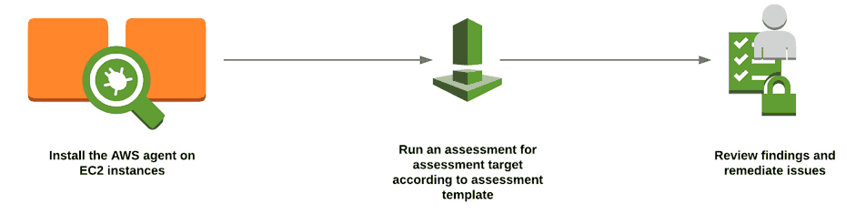
Widely Used Services in AWS
Amazon Inspector is an automated security assessment service that helps improve the security and compliance of applications deployed on AWS.

Slide 46
Widely Used Services in AWS
Amazon S3 access control lists (ACLs) enable you to manage access to buckets and objects.
Each bucket and object has an ACL attached to it as a subresource.
It defines which AWS accounts or groups are granted access and the type of access.
When a request is received against a resource, Amazon S3 checks the corresponding ACL to verify that the requester has the necessary access permissions.

Slide 47
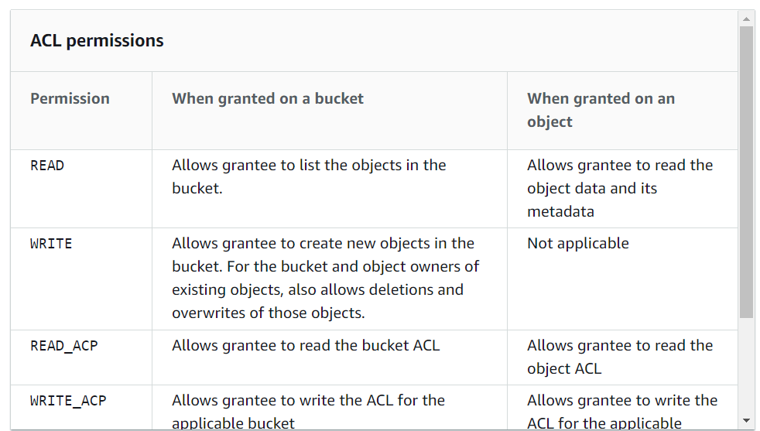
Widely Used Services in AWS

Slide 48
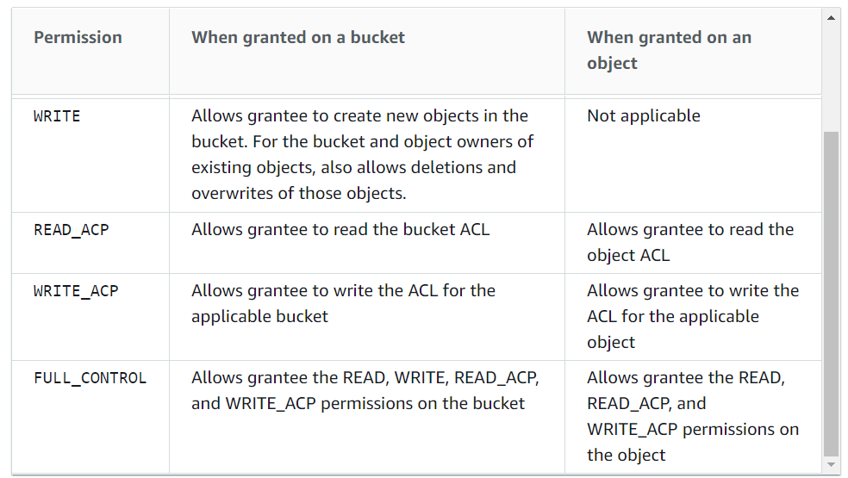
Widely Used Services in AWS

Slide 49
Widely Used Services in AWS
AWS CloudFormation gives you an easy way to model a collection of related AWS and third-party resources, provision them quickly and consistently, and manage them throughout their lifecycles, by treating infrastructure as code.
A CloudFormation template describes your desired resources and their dependencies so you can launch and configure them together as a stack.

Slide 50
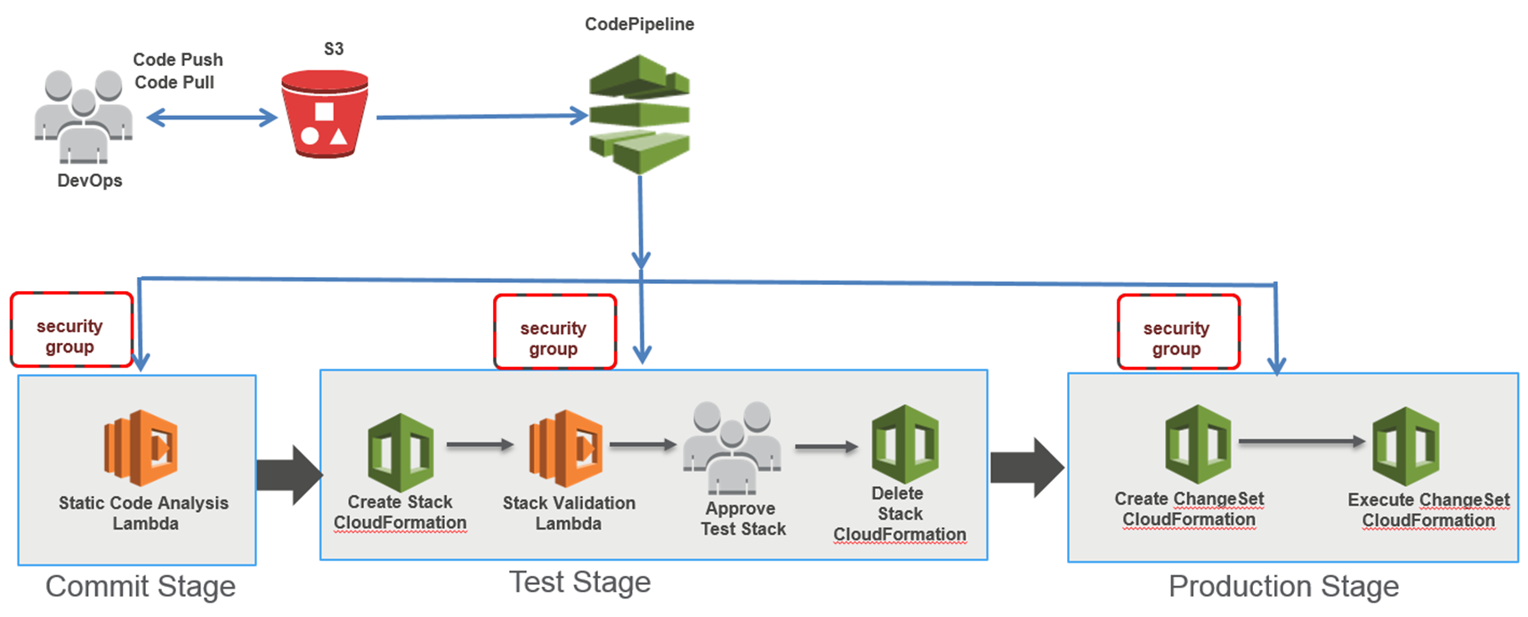
Widely Used Services in AWS

Slide 51

Widely Used Services in AWS

